Slide 1
FUTURE
UNICORNS
LAUNCHPAD
Intel – Get Set Learn
INDIA'S BIGGEST ENTREPRENEURSHIP TALENT HUNT PLATFORM FOR STUDENTS
PROGRAM TENURE
APRIL TO AUGUST 2023
POWERED BY

Slide 2
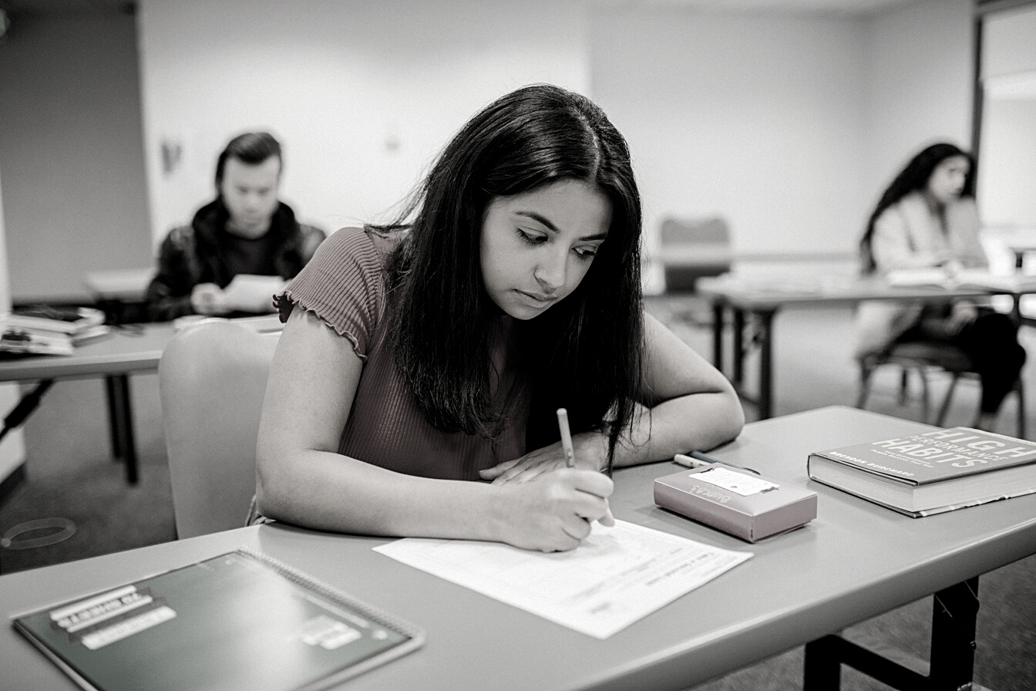
PROGRAM & SCHEDULE
PHASE 1
PHASE 2
PHASE 3
10 Apr - 30 June
20 May - 15 July
9 & 10 August
Entrepreneurship Quiz
Business Plan Pitch
Entrepreneurship Bootcamp
STUDENTS PARTICIPATE IN A NATIONAL LEVEL
QUIZ PREPARED BY TIE BANGALORE
SHORTLISTED STUDENTS DEVELOP INNOVATIVE
STARTUP IDEAS & PARTICIPATE IN AN ONLINE PITCH ROUND
SHORTLISTED TEAMS PARTICIPATE IN A 2-DAY
POWER-PACKED EVENT IN BENGALURU
15,000 STUDENTS
QUALIFIER ROUND
QUIZ CONDUCTED IN SCHOOLS
ONLINE & OMR FORMAT
750 STUDENTS
LIVE MENTORING BY TIE EXPERTS
VETTED BY TIE BANGALORE JURY
COMPRISING FOUNDERS AND CEOS
50 STUDENTS/25 TEAMS
ELEVATOR PITCHES AND AWARD CEREMONY
1 DAY STARTUP VISIT TO FAMOUS STARTUPS
INSPIRING SESSIONS BY UNICORNS & FOUNDERS

Slide 3
Reach via Get Set Learn, An Arvind Mafatlal Group Company
50K
500 +
75+
EMAIL SUBSCRIBERS
TOP SCHOOLS
LEARNING PARTNERS
Leveraging the AMG Group’s Legacy and Experience in Schools
100+
85%
2500+
YEARS EXPERIENCE WORKING WITH SCHOOLS
MARKET SHARE IN UNIFORMS SUPPLY UNIFORMS
WORKSHOPS & COURSES CONDUCTED FOR STUDENTS
3000+
10+
POWERED BY
EVENT ATTENDANCE
PRODUCT SHOWCASE SESSIONS

Slide 4
LANDMARK OPPORTUNITY FOR YOU TO EMPOWER TOMORROW'S ENTREPRENEURS
Grades
8-12
GET A PERFECT LAUNCHPAD TO DEVELOP AND HONE
ENTREPRENEURSHIP TALENT
100+
STARTUP FOUNDERS
FROM TOP COMPANIES IN BANGALORE /ALL OVER INDIA
15000+
STUDENT PARTICIPATION FROM ALL OVER INDIA
250+
ORIGINAL IDEAS
150+
TOP SCHOOLS
AND PITCH PRESENTATIONS BY STUDENT TEAMS TO EXCLUSIVE
TIE BANGALORE JURY
ICSE | CBSE | IB

Slide 5
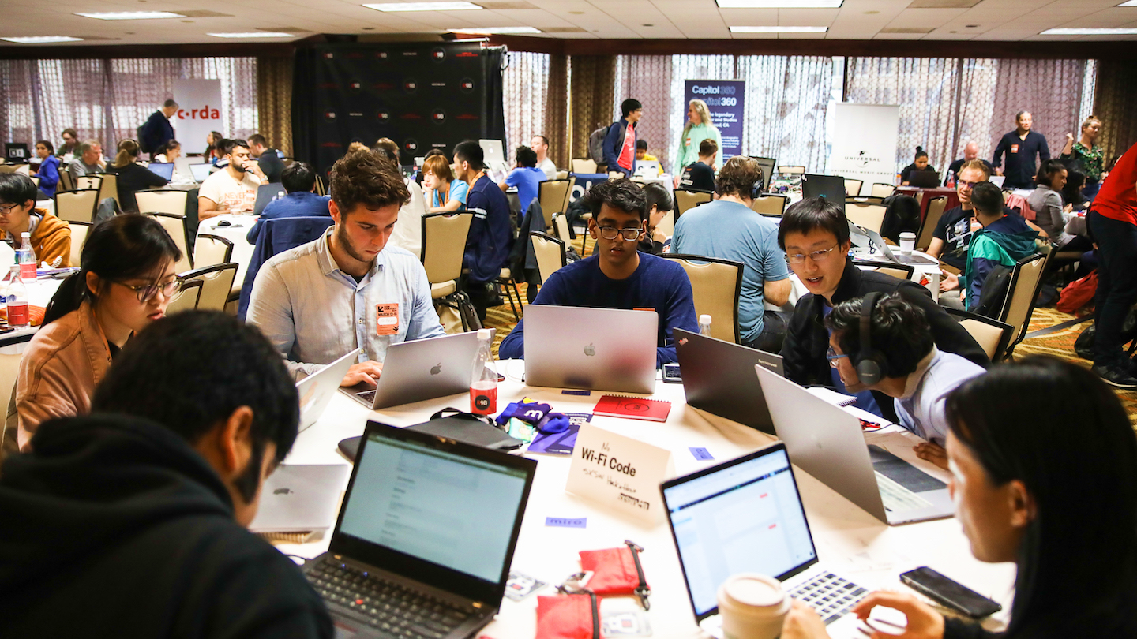
Entrepreneurship Bootcamp in Bengaluru
STUDENTS
9 & 10 August
GO ON A FIELD TRIP TO STARTUPS & FORTUNE 500 COMPANIES
NETWORK WITH
100+ STARTUP FOUNDERS
Top 75
SHORTLISTED STUDENT TEAMS
PRESENT ELEVATOR PITCHES
FROM TOP COMPANIES IN BANGALORE /ALL OVER INDIA
CONTESTS
& GIVEAWAYS
Top 25
TOP SCHOOLS
AND OPPORTUNITY FOR BRAND VISIBILITY & AWARENESS + PARTICIPATE AND NETWORK WITH STARTUP COMMUNITY
ICSE | CBSE | IB

Slide 6
FUL Deliverables for Partners
Logo integration on FUL collaterals [ brochure, website, other collaterals ]
15-mins slot as a speaker at the Entrepreneurship Bootcamp/Business Pitch Presentations
Include giveaways in our FUL STEM Entrepreneurship Cell Kit to schools on the final
event day [ 25 teams/schools ]
Social media coverage and PR coverage
Expectations from Partners
2-min Video of brand talking about entrepreneurship. This video will feature on the FUL website and social media pages
Promote Future Unicorns Launchpad Event on Uolo's social media (GSL will share creative)
Share options for giveaways to be included as part of STEM Entrepreneurship Cell Kit
Promoting 1 announcement on instagram/social media handles

Slide 7
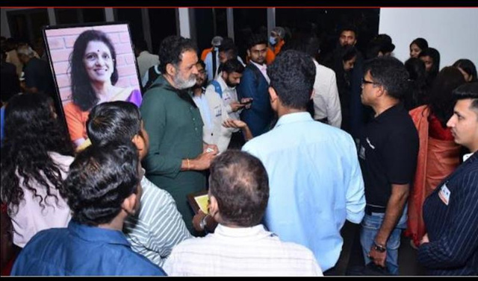
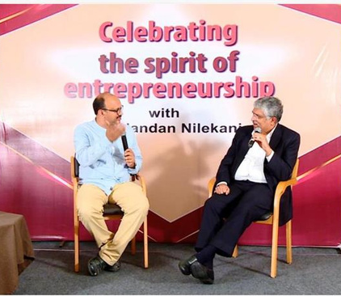
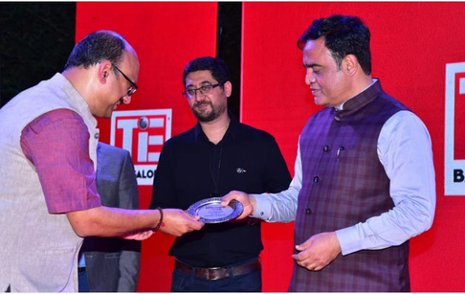
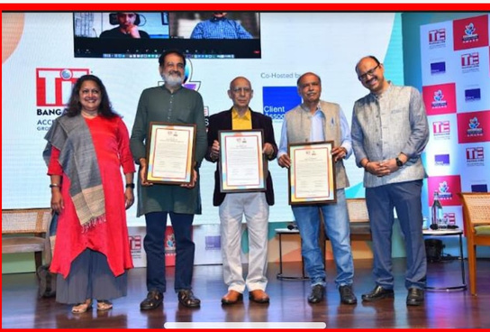
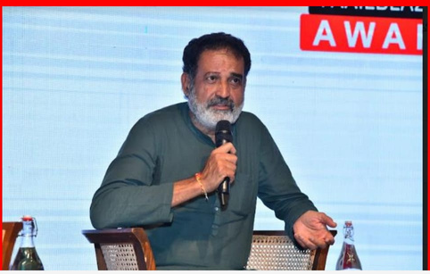
GLIMPSES FROM TiE and GSL BANGALORE PAST EVENTS
Entrepreneurship and startup events attended by business dignitaries such as Nandan Nilekani, Byju Raveendran, Madan Padki, Mohandas Pai, Captain Gopinath, among others.

Slide 8
LET'S WORK TOGETHER
Get in touch with us about event participation opportunities today
Shubhra Rishi
9967058105
shubhra.r@getsetlearn.info
Pradeep Ragav
www.futureunicorns.com
9663699916
pradeep.r@getsetlearn.info
POWERED BY

